Slide 1
Day 1

Slide 2
Knime Deep Learning Installation Guide

Slide 3
To run a deep learning in Knime Platform you need to…
Install Knime Analytics Platform
Install Anaconda
Install GPU dependencies
Configure Python Deep Learning Environment

Slide 4
Knime Analytics Platform Installation

Slide 5
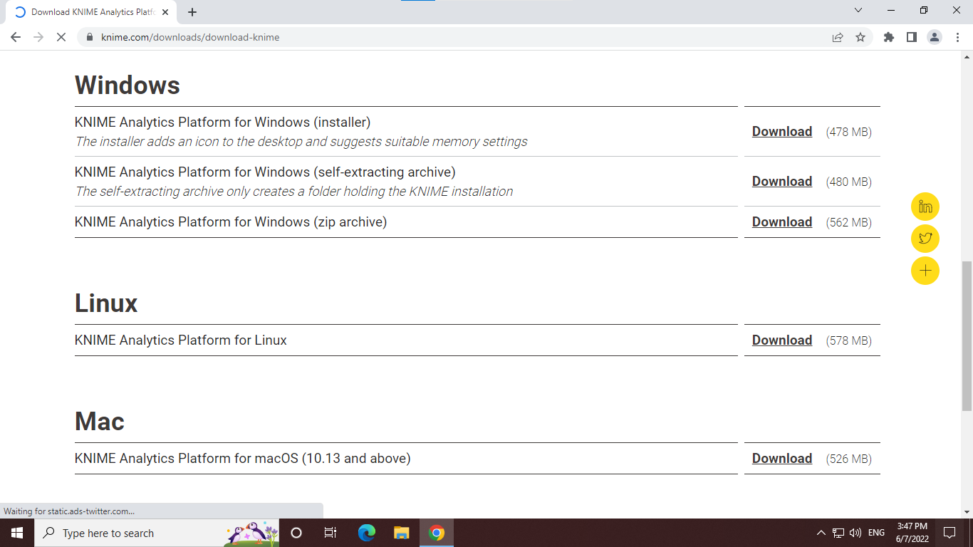
Installation Guide for Knime Analytics Platform
Go to Knime Webpage and click to Donwload button.
Fill in the required info and download the installer. Then, install
Select the installer for windows

Slide 6
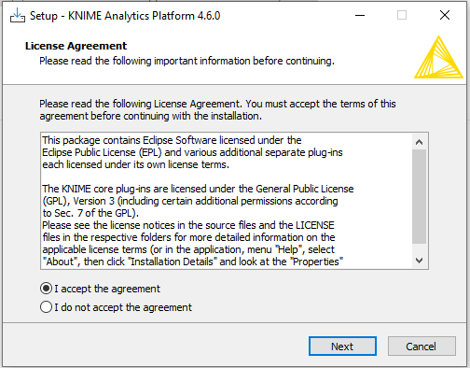
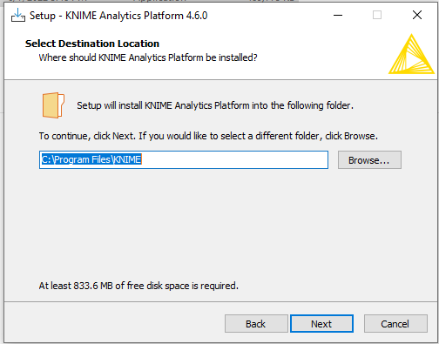
Double-click on the installer for installation configuration
By Default, Knime will locate at
c:\Program Files\Knime.
But you can put wherever appropriate location to your liking

Slide 7
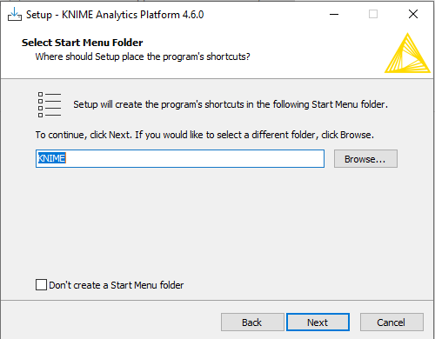
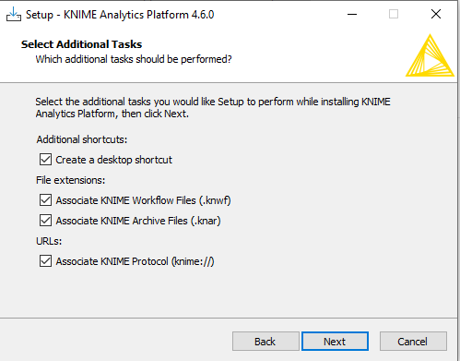
Name the Knime folder
Check all the additional tasks setting

Slide 8
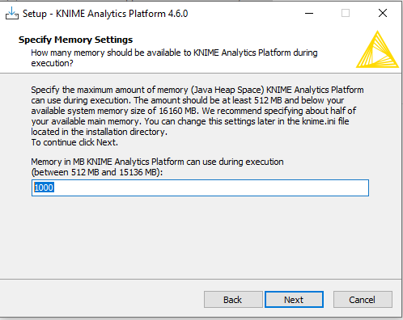
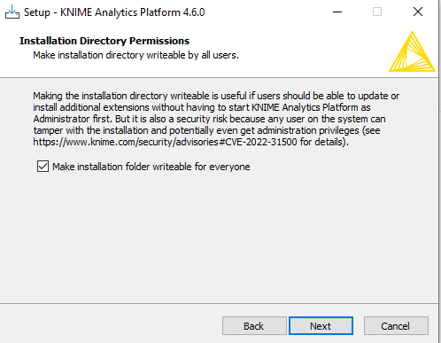
This dialog is for setting up RAM limitation for the Knime Analytics Platform to use.
Check the boxes and click next

Slide 9
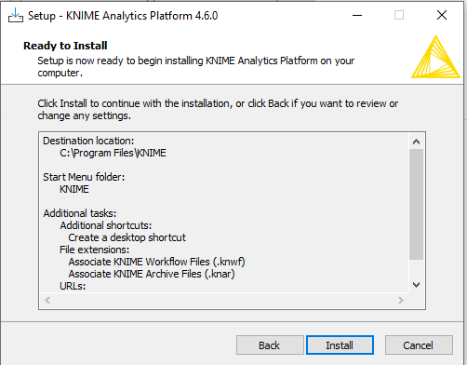
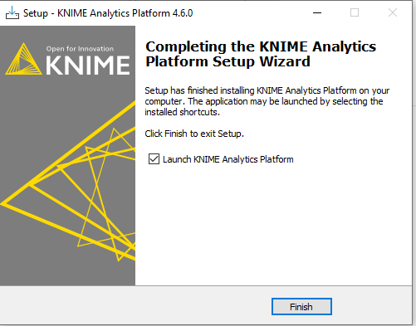
Start the installation
Installation finish

Slide 10
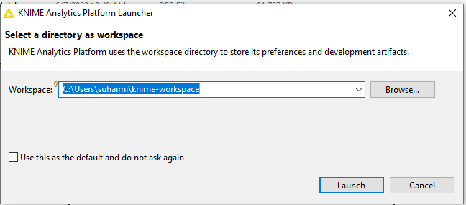
When the installation finish, launch the Knime Analytics platform.
A dialog will pop up. This is where you want to locate all your Knime workflow.
My recommendation is to put to a location for easy access.
You also can create more than one workspace and switch between them.

Slide 11
Install Knime Extensions
Knime have extensions and integrations that provide additional functionality such as access to and processing of complex data types, as well as the use of advanced algorithms.
To install Knime Extension, go to File > Install Knime Extensions
A dialog will pop up to list all the available extensions.

Slide 12
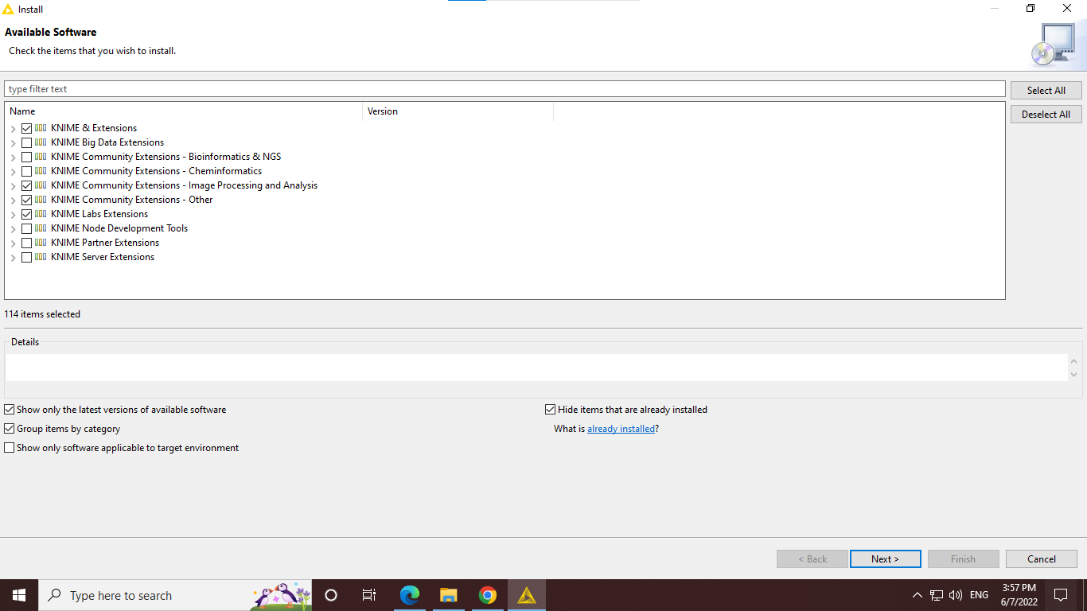
Tick all the require extensions for your projects, then click next

Slide 13
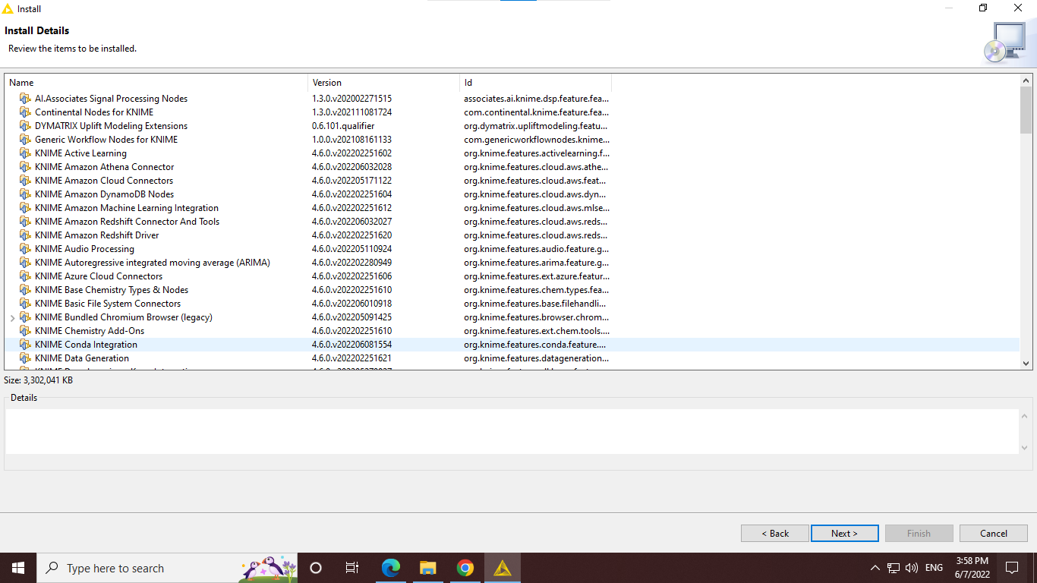
List of the extensions ready to install, then click next

Slide 14
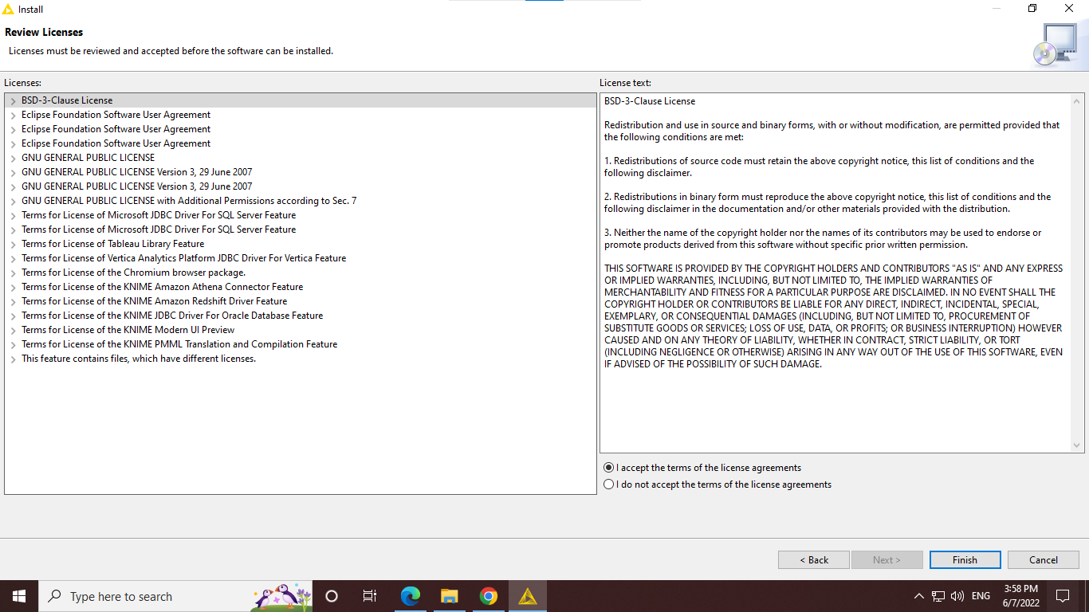
Accept the condition and click next

Slide 15
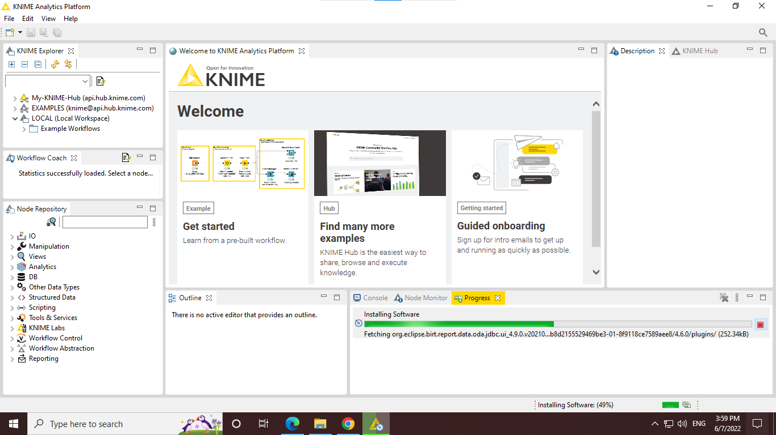
The installation will happen in the background. Wait for the installation to finish

Slide 16
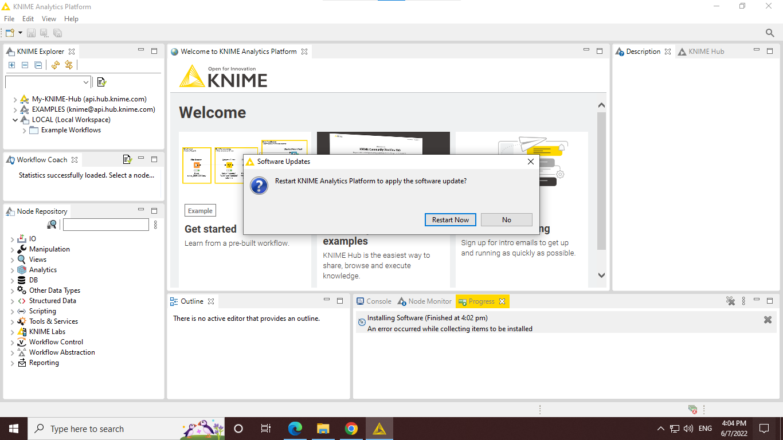
After installation is finish, a dialog to Restart will pop up. Click Restart Now button to re-launch the platform

Slide 17
KNIME Python Deep Learning

Slide 18
INTRODUCTION
Same as in python, Knime use anaconda to manage environment hence you need to install latest version of anaconda first.
It is crucial to manage your conda environment because because in Knime Deep learning, you can create environment with GPU and CPU ONLY.
I will further explain in detail in Configure Environment for Knime Deep Learning section.
But first why conda environment is important?
A conda environment is a directory that contains a specific collection of conda packages that you have installed.
If you change one environment, your other environments are not affected.
You can easily activate or deactivate environments, which is how you switch between them.

Slide 19
Anaconda Installation

Slide 20

How to install Anaconda
Get the latest Anaconda Installer in the Anaconda Website.

Slide 21
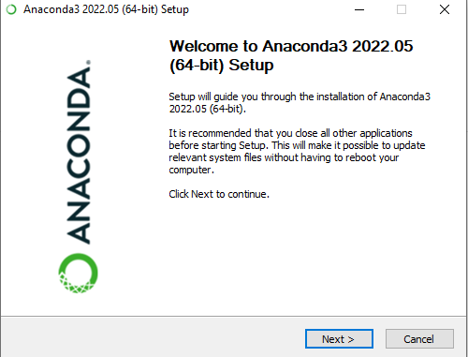
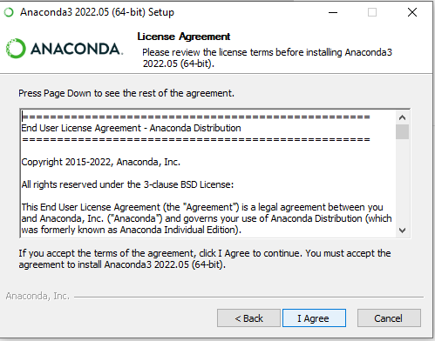
Agree to the condition
Run the installer then click Next

Slide 22
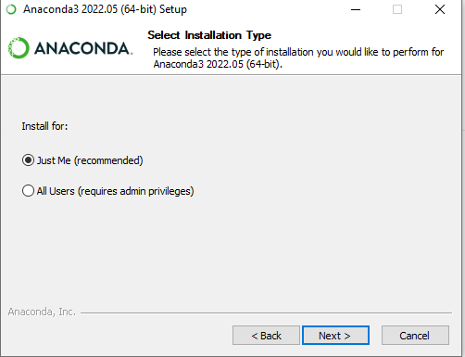
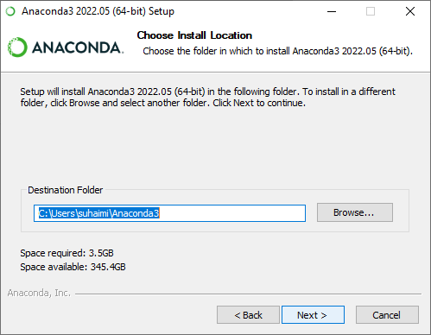
Two installation options. Check the Just Me then click Next
By default, Anaconda will install at this location.

Slide 23
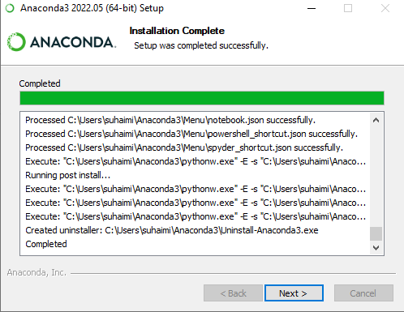
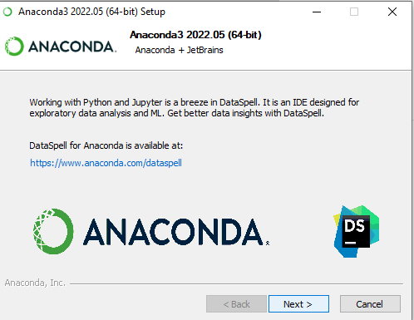
Click Next after Installation is complete

Slide 24

Click Finish

Slide 25
GPU Dependencies Installation

Slide 26
INTRODUCTION
Deep learning models have complex architecture compared to the traditional machine learning algorithm.
In this case, to train a model with only CPU is not a good choice as it will increase the workload of the CPU and consume your RAM and chances that you will encounter memory error would likely be high. Plus it also time consuming.
Common practice in deep learning, GPU is utilize to enhance and accelerate the model training.
Meaning with the presence of GPU, the computer performance will be optimized for the model training and also for the model to work during deployment.
There are THREE main components to install in your computer for GPU integration to work.

Slide 27
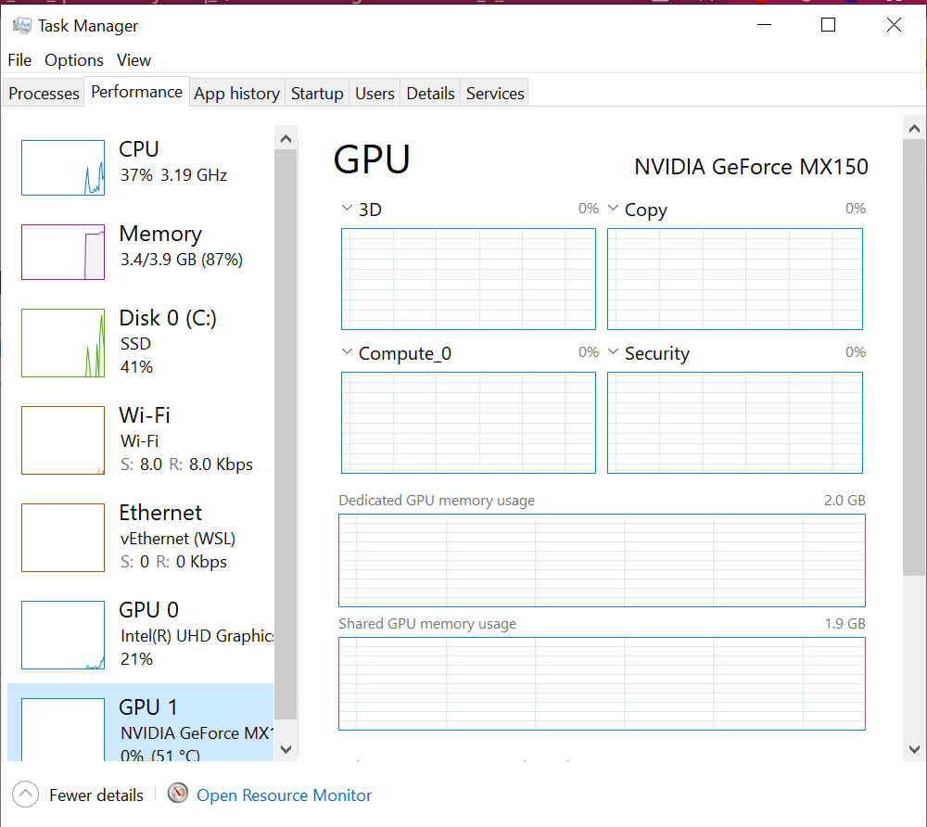
NVIDIA Driver
For now, deep learning with GPU integration only support NVIDIA GPU.
To install your NVIDIA GPU driver, you can go to this webpage.
Select your computer NVIDIA driver version. If you are not sure of your NVIDIA GPU version, go to TASK MANAGER->performance->GPU

Slide 28
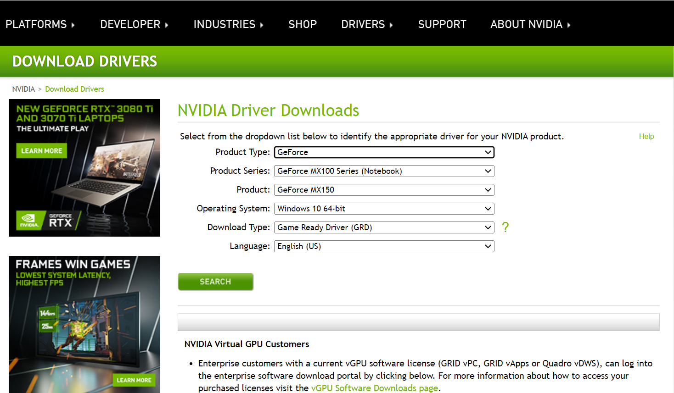
Download your desire driver version. Then, install the driver to your computer

Slide 29
2. CUDA Toolkit - for Tensorflow Integration only
The CUDA Toolkit from NVIDIA provides everything you need to develop GPU-accelerated applications. The CUDA Toolkit includes GPU-accelerated libraries, a compiler, development tools and the CUDA runtime.
GPU support for the KNIME TensorFlow Integration (which uses the TensorFlow Java API) is generally independent of the GPU support the KNIME Keras Integration (which uses Python). Hence, they have to be set up individually.
KNIME TensorFlow Integration uses TensorFlow version 1.13.1 which CUDA® Toolkit - TensorFlow (≥ 1.13.0) supports CUDA® 10.0.
Make sure to install CUDA 10.0. CUDA 10.1 will not work.
More details can refer to Deep Learning Installation Guide from Knime Documentation website

Slide 30
3. cuDNN package - for Tensorflow Integration only
The NVIDIA CUDA® Deep Neural Network library (cuDNN) is a GPU-accelerated library of primitives for deep neural networks.
cuDNN provides highly tuned implementations for standard routines such as forward and backward convolution, pooling, normalization, and activation layers.
In Knime cuDNN - (version ≥ 7.4.1) is required. Go to the webpage and select cuDNN v7.6.0 (May 20, 2019), for CUDA® 10.0 to download the zip file.
Open the cuDNN zip file and copy all the folder into CUDA folder (default path: C:\Program Files\NVIDIA GPU Computing Toolkit\CUDA\<cuda_version)

Slide 31
Next, we have to configure the path for the CUDA and cuDNN to work.
Go to search bar and open “edit system environment variable” and add the following to both user and system path variables:
<INSTALL_PATH>\NVIDIA GPU Computing Toolkit\CUDA\v10.0\bin <INSTALL_PATH>\NVIDIA GPU Computing Toolkit\CUDA\v10.0\libnvvp <INSTALL_PATH>\NVIDIA GPU Computing Toolkit\CUDA\v10.0\include <INSTALL_PATH>\NVIDIA GPU Computing Toolkit\CUDA\v10.0\extras\CUPTI\lib64
Now, everything is configured to utilize GPU for keras and tensorflow for deep learning

Slide 32
Configure Python Deep Learning Environment

Slide 33
Configure Environment for Deep Learning
There are TWO options to configure Knime Deep Learning Environment either manually or automatically by Knime special Deep Learning configuration.
The Special Deep Learning configuration dialog assist you to install all the dependencies and packages without the hassle of coding.
The downside is, it only install the essential python deep learning packages.
If you wish to add other dependencies and packages that are require for your project you can go to the manual installation.
This slide will only go through the automatic configuration.
If you wish to configure environment manually, please refer to Knime Manual Python Installation documentation

Slide 34
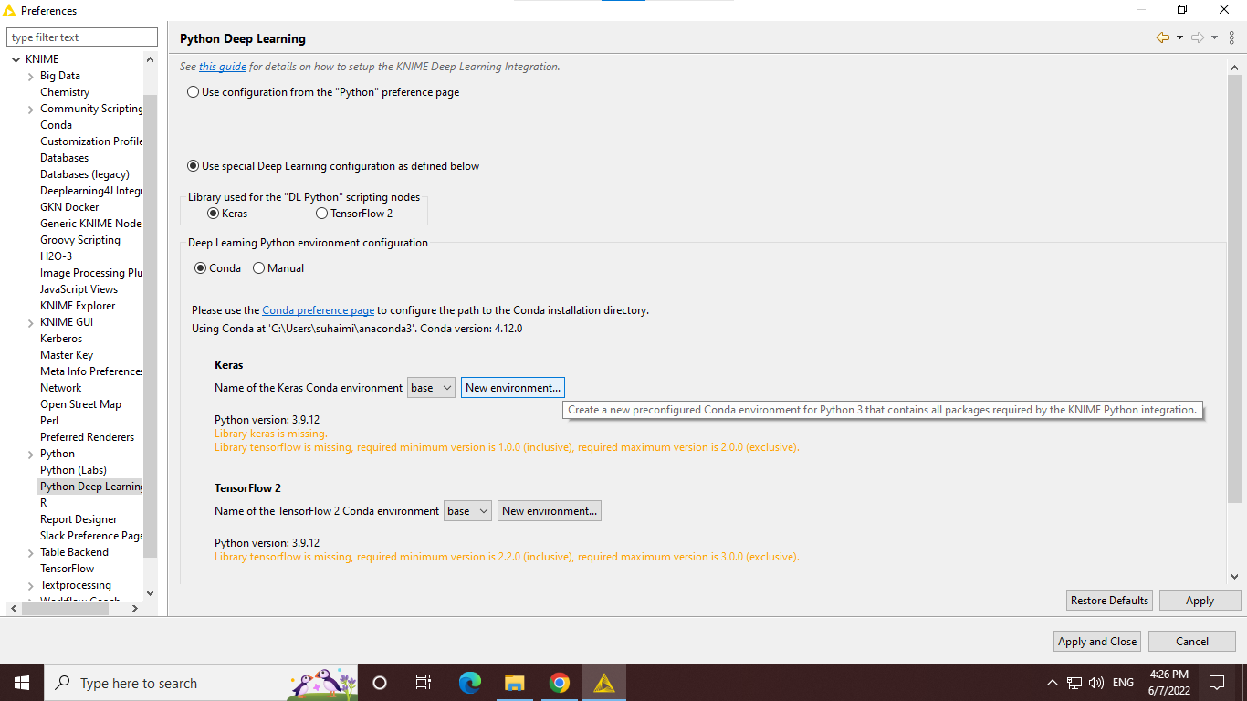

Slide 35
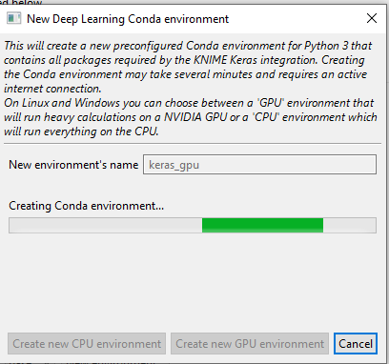
Click to the new environment, and it will open this dialog.
You can select either to create GPU or CPU environment.
Knime will automatically configure and install all the necessary packages for python deep learning.

Slide 36
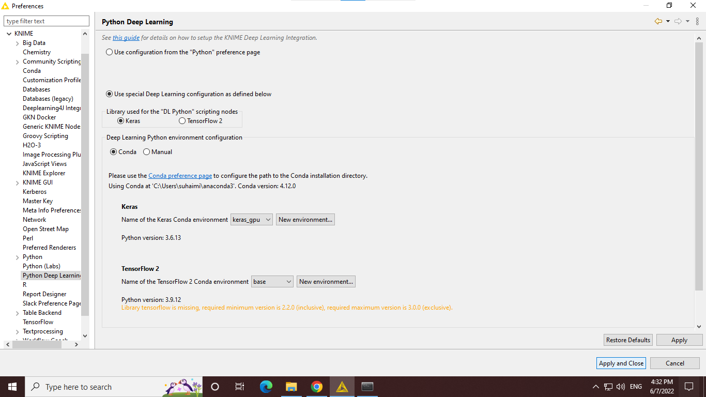
Now you already have your python deep learning environment.
Wait for the configuration to finish then click apply and close.

Slide 37
References
https://docs.knime.com/2019-06/deep_learning_installation_guide/index.html#_configure_python_for_knime_deep_learning
https://docs.knime.com/2019-06/deep_learning_installation_guide/index.html#_introduction
https://docs.anaconda.com/anaconda/install/windows/

